Slide 1
Instructional Prototype
EDIT 730 TSCLE Final Project | Dec 2022 | Sid Yi
Skip to start of prototype

Slide 2

Proposal

Slide 3

Instructional Problem
How can Permanent Makeup provide gender euphoria?
PMUAs seeking to cater to LGBTQIA+ people should be educated in the proper language and bedside manner when conducting these procedures
What techniques can be used to make desired features more pronounced, less pronounced, or more masculine or feminine in nature
Notes:
Many people are unaware of the benefits permanent makeup and restorative paramedical tattoos can provide for those seeking gender-affirming procedures.
Permanent makeup artists should serve as advocates for their clients, and be well-educated in Permanent Makeup’s ability to provide gender euphoria. PMUAs seeking to provide these services to their clientele should also be educated in the proper language and bedside manner when conducting these procedures to build trust and ensure the client is comfortable with the artist.
In addition, there are certain techniques that can be used when mapping out permanent makeup to make desired features more pronounced, less pronounced, or more masculine or feminine in nature. These techniques are not taught in traditional PMUA academies and PMUAs with LGBTQ+ clients should be aware of how to give the client their desired look in order to bring about gender euphoria.

Slide 4
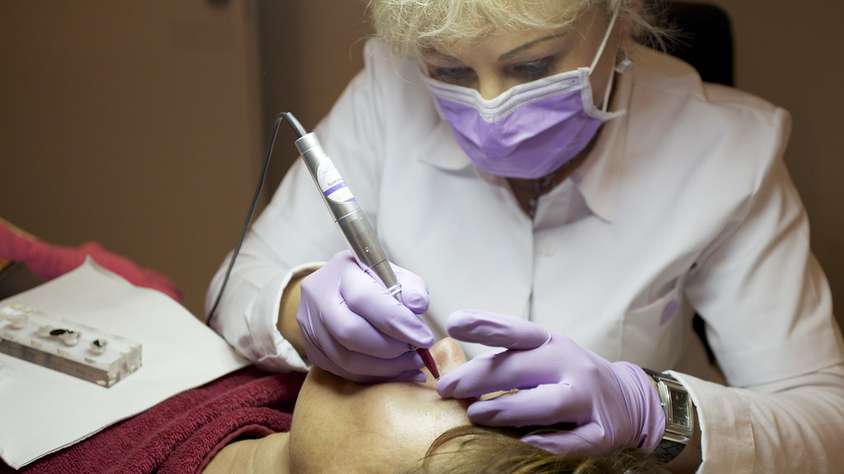
Target Audience
Permanent makeup and restorative tattoo artists
This Photo by Unknown Author is licensed under CC BY-SA
Notes:
The target audience of this instruction are practicing Permanent and restorative tattoo artists

Slide 5
Learning Outcomes
Recognize the benefits and importance of gender-affirming permanent makeup
Demonstrate knowledge of proper gender-inclusive terminology
Develop an awareness to proper terminology and conversational skills needed to improve bedside manner when working with LGBTQ+ Clients
Execute proper facial mapping techniques based on the desired gender-affirming outcome
Exemplify aspects of a gender-inclusive space
Notes:
Artists should learn the importance and benefits of gender affirming permanent makeup, as well as develop and demonstrate knowledge of terminology, and bedside practices. In addition, artists will learn facial mapping techniques to cater to clients desired outcomes. Finally, they will finish instruction with the summary of how they may create a gender-inclusive space in their studio

Slide 6

Learning Models
Supportive
  Videos, infographics and aids
Dialogic
  Reflection
  Collaboration and Social Negotiation
Notes:
The instruction will focus on a supportive learning model, mainly consisting of micro-lectures in the form of videos. In addition, they will be provided a few reflection activities, and be encouraged to engage in the Community of Practice via a Discord Server

Slide 7
Design Table
Notes:
Let’s take a look at the design table

Slide 8
Learning Outcomes (Come from Proposal) | Instructional Strategies | Learning Activities/Tasks (Should be reflected in Prototype) | Learning Technologies | Assessment and Evaluation Criteria
Recognize the benefits and importance of gender-affirming permanent makeup | Reflection, Modeling and explaining. | Learners will be prompted to reflect on a time when they felt their gender was affirmed. Even if cisgender, does makeup, PMU, or clothing make you feel happy and like yourself? Learners will then write a short answer on what makes them feel affirmed in their gender or other identities. Learners will then watch a short lecture on what gender affirmation/euphoria, and view examples of how PMU can help individuals to achieve affirmation and euphoria. | LMS | Instructor will assess learner’s reflection. Initial assessment to be utilized to see individual learner’s progression.
Exemplify aspects of a gender-inclusive space | Modeling and explaining, reflection | Learners will be given micro lectures on the topic of creating a gender-inclusive space, (what aspects does it include, why it’s important, and what one may look like). In addition, they may be presented with infographics on the concepts from the micro lecture that they may print and use at a later time or for reference. Finally, learners will be tasked with creating their own inclusive space statement. | Video, content creation tools | Instructor will evaluate and provide feedback on the learner’s inclusive space statement. Assessment will be guided by a rubric as well as the individual artists’ goals and abilities.
Develop an awareness to proper terminology and conversational skills needed to improve bedside manner when working with LGBTQ+ Clients | Modeling and explaining, reflection | The learner will be presented with a micro lecture on proper conversational and bedside manner. After the lecture is presented, students will be given the opportunity to walk through a POV video simulation where they will be prompted to pause the video or the video will give them time to answer while walking through as a client at a studio. Learners will then be asked to provide short reflections on what aspects they learned and could be providing to their clientele along with the opportunity to ask for clarification | Video, content creation tools | Instructor will provide feedback on the learner’s reflection.
Execute proper facial mapping techniques based on the desired gender-affirming outcome | Modeling and explaining | Learners will be given micro lectures on how PMU can enhance certain characteristics, and how to utilize mapping to match the client’s desired effect. In addition, they may be presented with infographics on the concepts from the microlecture that they may print and use at a later time or for reference | Video, LMS | Learners will be presented with example maps and asked to match them with the proper desired outcome
Demonstrate knowledge of proper gender-inclusive terminology | Modeling and explaining | Micro lectures will be used to teach students the proper terminology and its meanings, along with historical context when needed. | Video, LMS | Learners will complete a quiz with immediate feedback on incorrect answers in order to assess their understanding of the terminology.
Notes:
As noted in the Learning models slide and in this table, the learning activities will mainly be supported by videos and LMS tools to support micro-lectures, and reflection activities. These reflections will be assessed by an instructor who will provide individualized feedback. In addition there will be some online quizzes provided by the LMS in order to assess more fact-based information. Online quizzes will provide immediate feedback for selected answers so that the student will know why their answer was correct or incorrect.

Slide 9
Prototype
Notes:
Now that we’ve covered the basics of the protype, let’s see it in action

Slide 10

Instructional Prototype
Launch Learning Platform
Launch Discord Server
This Photo by Unknown Author is licensed under CC BY-SA-NC
Notes:
The PMU in transition website will have a password-protected landing page for the instruction. One icon will prompt learners to launch the LMS, the other will prompt learners to open the discord server

Slide 11
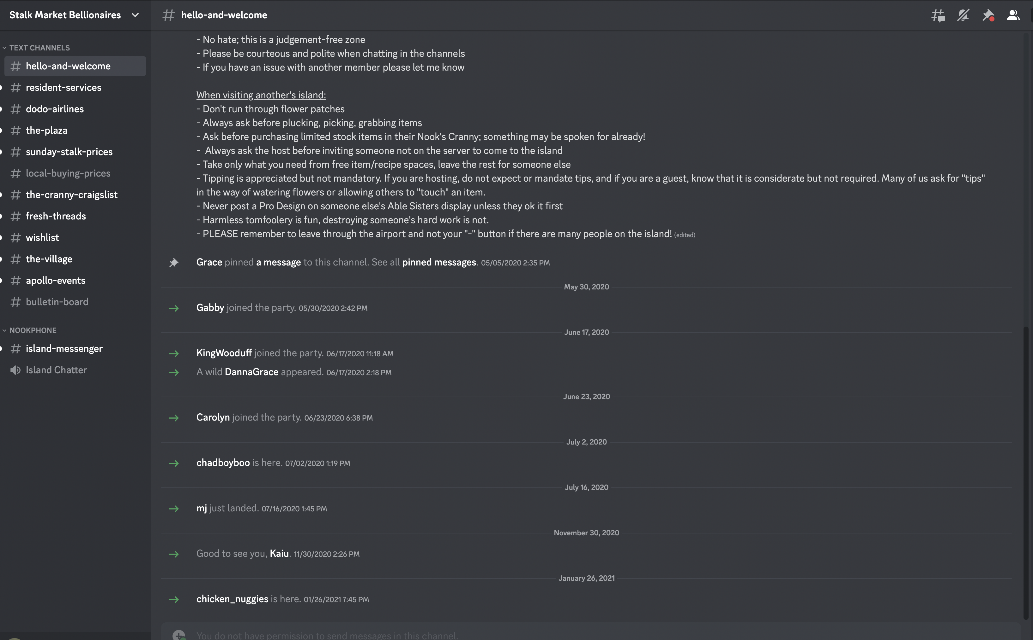
Discord Server Example
Notes:
Discord will allow users to organize thoughts and ask questions in an organized manner. They will also be able to organize themselves by region, specialty, etc. so they may participate in a community of practice

Slide 12
Instructional Prototype
1. Introduction
2. Terminology
3. Bedside Manner
4. Facial Mapping
5. Make your Studio Inclusive
Notes:
The landing page for the LMS will present all of the curriculum up front, in numbered order

Slide 13
Instructional Prototype
Introduction
Gender- affirming tattoos are an important service to those in transition and can often be a more affordable and attainable transitional tool for transgender individuals.
PMU in Transition is here to help you bridge the gap with the social aspects of working with gender expansive folks that are not covered in technical tattoo training to ensure the best possible experience for current and future clients seeking gender-affirming services.
Back
Next
Notes:
Learners are met with a brief overview of the goal of the program, as well as what gender-affirming tattoos can achieve

Slide 14
Instructional Prototype
Introduction
Tell me about this memory. How do you think your skills as a tattoo artist can help Transgender or gender-nonconforming people feel this same joy?
Enter your response here
Think back to a time when you felt happiest in your body. Did you find an item of clothing, makeup product, or get a compliment that made you feel good about how you present yourself to the world?
Back
Cancel
Submit
Notes:
Learners are then immediately presented with a reflection activity so that they can more easily put themselves in the shoes of the clientele they are looking to better serve with the instruction.

Slide 15

Instructional Prototype
Introduction
Back
Next
Notes:
Next, a more in-depth microlecture on the subject of gender-affirming tattoos, and their importance to the LGBTQIA+ community will be shown

Slide 16
Instructional Prototype
1. Introduction
2. Terminology
3. Bedside Manner
4. Facial Mapping
5. Make your Studio Inclusive

Slide 17
Instructional Prototype
Terminology
Back
Next
Notes:
Terminology will consist of a micro-lecture with visual animations

Slide 18
Instructional Prototype
Terminology Quiz
What does the term “Cisgender” mean?
Someone who identifies as their sex assigned at birth
Someone who identifies as something other than their sex assigned at birth
Someone who does not identify as any gender
Someone who is actively undergoing transition
Feedback:
The term “Cis” comes from the Latin prefix “Cis” meaning “on this same side”, Cisgender people identify as the same sex they were assigned at birth
Back
Next
Notes:
In order to assess the factual knowledge gained, a quiz will be presented following the microlecture.
Feedback will be provided immediately by the LMS in order to ensure the quiz is meaningful

Slide 19
Instructional Prototype
1. Introduction
2. Terminology
3. Bedside Manner
4. Facial Mapping
5. Make your Studio Inclusive
Notes:
Next, we see the prototype for Bedside manner

Slide 20
Instructional Prototype
Bedside Manner
Back
Next
Notes:
This instruction will consist of a video simulation rather than a microlecture. The leaner will play the role of a tattoo artist welcoming a client seeking gender-affirming services. The video will pause during checkpoints where the learner is asked questions by either the client or the narrator of the simuation.

Slide 21
Instructional Prototype
Bedside Manner
Tell me about what surprised you in the simulation. What, if anything was something within the client experience you hadn’t previously considered?
Enter your response here
Think back to the video simulation. Were there any aspects of the simulation you struggled with? What surprised you?
Back
Cancel
Submit
Notes:
The learner will reflect on the simulation

Slide 22
Instructional Prototype
Bedside Manner
We encourage you to head to the discord server to continue discussing challenging or surprising aspects of the simulation, or comment on aspects we may have missed.
How have others in the PMUA community made changes in their personal bedside manner?
Launch Discord Server
Back
Next
This Photo by Unknown Author is licensed under CC BY-SA-NC
Notes:
Next, the learner will be encouraged to utilize the discord server to discuss with peers and experts on their experience with the simulation

Slide 23
Instructional Prototype
1. Introduction
2. Terminology
3. Bedside Manner
4. Facial Mapping
5. Make your Studio Inclusive
Notes:
Our next module will be facial mapping

Slide 24
Instructional Prototype
Facial Mapping
Back
Next
Notes:
The learner will be presented a microlecture video on facial mapping

Slide 25
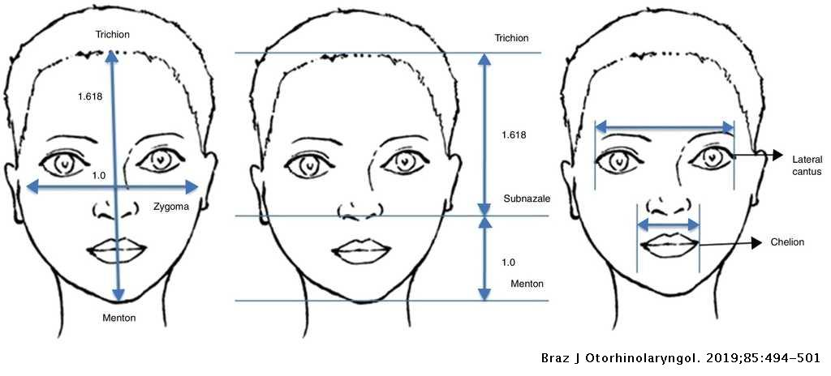
Instructional Prototype
Facial Mapping
Download Facial Map Infographic
This Photo by Unknown Author is licensed under CC BY
Back
Next
Notes:
The learner will have the opportunity to view and download job aids for facial mapping techniques immediately following the micro lecture

Slide 26
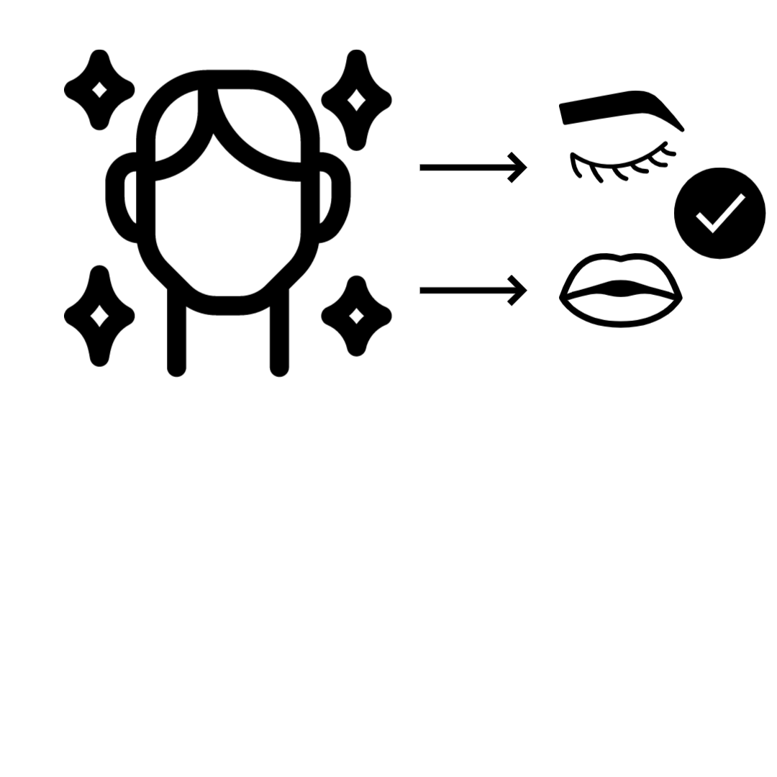
Instructional Prototype
Facial Mapping
Back
Next
Notes:
Students will be presented with a short quiz on concepts of facial mapping. Again the quiz will provide immediate feedback on why the answers are correct/ incorrect

Slide 27
Instructional Prototype
1. Introduction
2. Terminology
3. Bedside Manner
4. Facial Mapping
5. Make your Studio Inclusive
Notes:
Finally, we end with a subject that encompasses all previous moduls

Slide 28
Instructional Prototype
Inclusive Spaces
Back
Next
Notes:
Learners will be presented with a microlecture on how and why they should make their studios inclusive for those in the gender-expansive and LGBTQ+ community.

Slide 29
Instructional Prototype
Inclusive Spaces
Create your own Inclusive Space Statement using the rubric provided.
 | States the studio’s goal of inclusivity | States artist responsible for upholding inclusive policies | States how extent of artist personal abilities to maintain inclusivity
Clearly states
Might be inferred
Does not clearly state
Enter your response here
Cancel
Submit
Back
Notes:
Learners will then be asked to create their own inclusivity statement following a rubric provided.

Slide 30
Instructional Prototype
1. Introduction
2. Terminology
3. Bedside Manner
4. Facial Mapping
5. Make your Studio Inclusive

